Slide 1

Text & Sentiment Analysis of PM Speech and Comment
A Comprehensive Analysis
By
Akshay Kul

Slide 2
Introduction
Objective : Analyzing the PM's speech and sentiments from YouTube comments
A comprehensive analysis of the Prime Minister's speech, coupled with sentiment analysis on YouTube comments related to the speech. This project delves into the fascinating world of Natural Language Processing (NLP) to derive insights from both structured and unstructured data sources.
Our main objectives include understanding the key themes of the PM's speech through text analysis, creating a Term-Document Matrix (TDM) to uncover word frequency patterns, and gauging public sentiment through sentiment analysis on YouTube comments.
Let's explore how these analyses come together to provide a nuanced perspective on public reactions and the overall impact of the speech.

Slide 3
Index
Speech Text Analysis
Data Collection
EDA
Term-Document Matrix (TDM)
Word Cloud
Sentiment Analysis on YouTube Comments
Data Collection
EDA
Term-Document Matrix (TDM)
Word Cloud
Sentiment Analysis
Conclusion

Slide 4
Speech Text Analysis
Data Collection:
Gathered data from reputable news websites to ensure a comprehensive view of the speech.
Website - https://timesofindia.indiatimes.com/world/uk/text-of-rishi-sunaks-first-speech-as-uk-prime-minister/articleshow/95080536.cms
Exploratory Data Analysis (EDA):
Conducted Exploratory Data Analysis to convert the Unstructured data to Structured Data to gain preliminary insights into the structure and characteristics of the speech text.
Lowercasing
Removing Punctuation, URLs, Stop Words, Common Words
Lemmatization
Library use – NLTK

Slide 5
Speech Text Analysis
Term-Document Matrix (TDM):
The Term-Document Matrix (TDM) is a fundamental concept in Natural Language Processing (NLP) and text mining. It's a mathematical representation of a text corpus that reflects the frequency of terms across documents.
Libraries use - scikit-learn’s, Count Vectorizer
Word Cloud:
It provides a quick and intuitive overview of the key terms and themes.
Library use - WordCloud

Slide 6
B. Sentiment Analysis on YouTube Comments
Objective: Understand public sentiment towards the PM's speech
Data Collection:
Data is Collected from PM Speech on You Tube BBC Channel
With the help of API and Google cloud YouTubedata API data is collected
Exploratory Data Analysis (EDA):
Conducted Exploratory Data Analysis to convert the Unstructured data to Structured Data to gain preliminary insights into the structure and characteristics of the speech text. Preprocessing decisions made based on the nature of YouTube comments
Lowercasing
Removing Punctuation, URLs, Stop Words, Common Words
Lemmatization
Library use – NLTK

Slide 7
B. Sentiment Analysis on YouTube Comments
Term-Document Matrix (TDM):
The Term-Document Matrix (TDM) is a fundamental concept in Natural Language Processing (NLP) and text mining. It's a mathematical representation of a text corpus that reflects the frequency of terms across documents.
Libraries use - scikit-learn’s, Count Vectorizer
Word Cloud:
It provides a quick and intuitive overview of the key terms and themes.
Library use - WordCloud

Slide 8
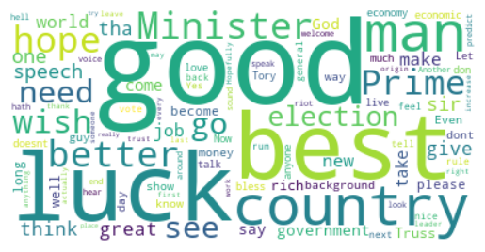
B. Sentiment Analysis on YouTube Comments
Word Cloud:

Slide 9
B. Sentiment Analysis on YouTube Comments
Sentiment Analysis :
Determining the sentiment expressed in a piece of text whether the text conveys a positive, negative, or neutral sentiment. Polarity is a key concept in sentiment analysis, representing the degree of positivity or negativity in a text.
Positive Polarity: A positive polarity indicates a favorable or positive sentiment in the text. Words and phrases expressing joy, satisfaction, approval, or positive experiences contribute to positive polarity.
Negative Polarity: A negative polarity indicates an unfavorable or negative sentiment. Words and phrases conveying disappointment, dissatisfaction, criticism, or negative experiences contribute to negative polarity.
Neutral Polarity: A neutral polarity suggests the absence of strong positive or negative sentiment. Text with a neutral polarity may describe facts or provide information without expressing a clear emotional tone.
Polarity scores are often represented on a continuous scale, ranging from -1 to 1.
Positive Polarity: Score close to 1
Negative Polarity: Score close to -1
Neutral Polarity: Score close to 0

Slide 10
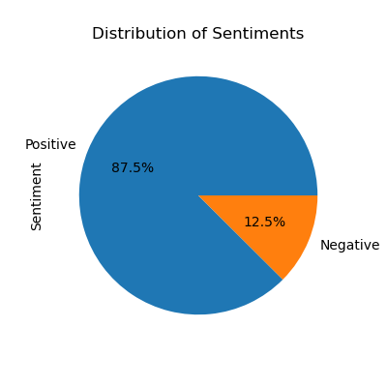
B. Sentiment Analysis on YouTube Comments
Sentiment Analysis :

Slide 11
Conclusion
From PM Speech Analysis
PM is talk about Future, Economic, Trust, Rights, Protect, Stand, Growth, Incredible towards the nation.
From Sentiment Analysis on YouTube Comments
There is 88% people Positive with PM Speech and there vision.

